Slide 1

PROJECT CARD & DATA OVERVIEW [SKIP IF FAMILIAR]
EASY
ADVANCED

Slide 2
HYPERPRAMETERS OPTIMIZATION RECAP
Hyperparameters optimization is the problem of choosing a set of optimal hyperparameters for a given machine learning algorithm.
A hyperparameters are used to control the learning process and are set before the training job starts.
After training multiple models, you would like to fine tune them so that they perform better on a given dataset.
HYPERPARAMETER
PARAMETER
Parameter: values that are obtained by the training process such as network weights and biases.
Hyper parameter: values set prior to the training process such as number of neurons, layers, learning rate..etc

Slide 3
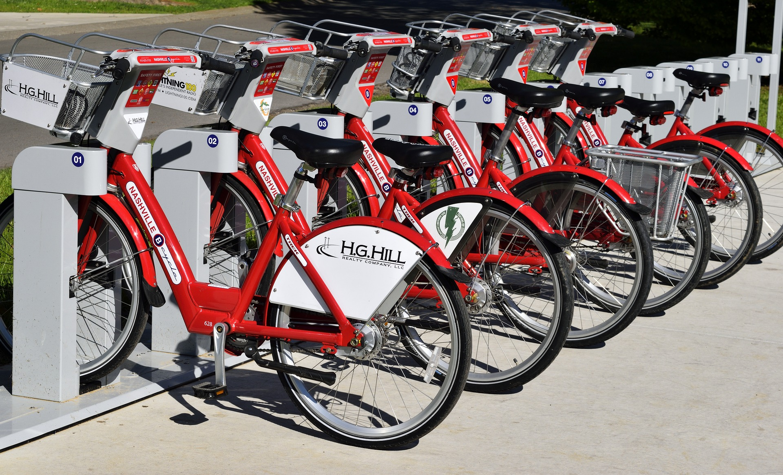
PROJECT CARD
GOAL:
Build, train, test and deploy a machine learning model to predict bike rental usage based on inputs such as temperature, humidity, wind speed..etc.
We will train a model and optimize its hyperparameters in SageMaker.
TOOL:
AWS SageMaker Studio (Hyperparameters Tuning Jobs)
PRACTICAL REAL-WORLD APPLICATION:
This project can be effectively used by bike rental shops to predict demand and expected future sales and understand key factors that contribute to generating revenue.
DATA:
INPUTS:
Instant, date, season, year, hour, month, holiday, weather situation, temperature, and windspeed.
OUTPUT:
casual: count of casual users
registered: count of registered users
cnt: count of total rental bikes including both casual and registered
Image Source: https://pixabay.com/photos/bike-rental-bikes-rent-pay-2284380/
Dataset Source: Hadi Fanaee-T, Laboratory of Artificial Intelligence and Decision Support (LIAAD), University of Porto INESC Porto, Campus da FEUP Rua Dr. Roberto Frias, 378 4200 - 465 Porto, Portugal
Image Source: https://www.flickr.com/photos/pasa/6757993805
Dataset Source: https://www.kaggle.com/ljanjughazyan/cars1

Slide 4
DATA EXPLORATION: INPUTS
Inputs:
instant: record index
dteday: date
season: season (1: springer, 2: summer, 3: fall, 4: winter)
yr: year (0: 2011, 1: 2012)
mnth: month ( 1 to 12)
hr: hour (0 to 23)
holiday: whether day is holiday or not - weekday : day of the week
Working day: if day is neither weekend nor holiday is 1, otherwise is 0.
weathersit :
1: Clear, Few clouds, Partly cloudy
2: Mist + Cloudy, Mist + Broken clouds, Mist + Few clouds, Mist
3: Light Snow, Light Rain + Thunderstorm + Scattered clouds, Light Rain + Scattered clouds
4: Heavy Rain + Ice Pallets + Thunderstorm + Mist, Snow + Fog
temp : Normalized temperature in Celsius. The values are divided to 41 (max)
windspeed: Normalized wind speed. The values are divided to 67 (max)
Outputs:
casual: count of casual users
registered: count of registered users
cnt: count of total rental bikes including both casual and registered

Slide 5
MODEL OVERVIEW
TEMPERATURE
WEATHER
TUNED MACHINE LEARNING REGRESSION MODEL
WINDSPEED
SEASON
BIKE USAGE COUNT (TOTAL)
MONTH

Slide 6
HYPERPARAMETERS OPTIMIZATION USING SAGEMAKER DEMO
EASY
ADVANCED

Slide 7
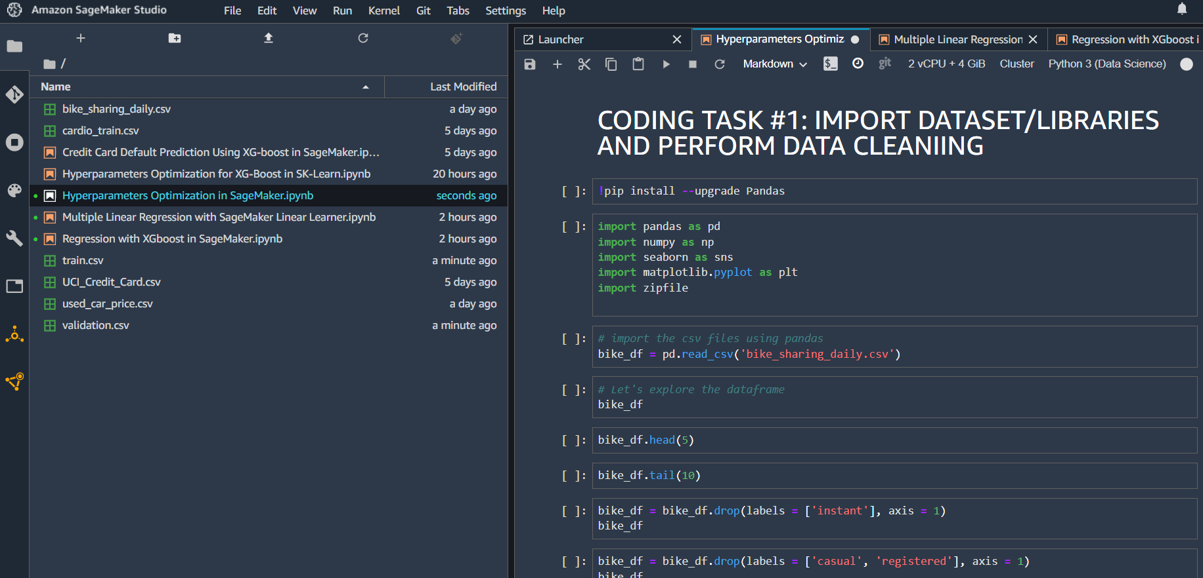
HYPERPARAMETERS OPTIMIZATION DEMO IN AMAZON SAGEMAKER

Slide 8
FINAL END-OF-DAY CAPSTONE PROJECT
EASY
ADVANCED

Slide 9
PROJECT
Using the used car prices dataset included in the course package, perform the following:
Load the “used_car_price.csv” dataset
Split the data into training, validation and testing
Train an XG-Boost model using SageMaker Built-in XG-Boost Algorithm
Assess trained XG-Boost model performance using various KPIs
Perform hyperparameters optimization using SageMaker SDK
Compare the performance of the tuned model using various KPIs. Comment on your results.

